Slide 1
What is a Customer Segmentation Model?
A customer segmentation model is a way of dividing a wide group of people into smaller groups based on their commonalities. How you divide your larger customer base into those smaller subgroups will vary based on what your brand does and who your customers generally are.
If you’re a business-to-business brand providing accounting services to small and medium-sized businesses, one of your segmentation models may focus on the different industries in which your customers’ businesses operate.
For a business-to-consumer brand, your customer segmentation models may focus on shared demographics like age, gender, and income level.

Slide 2
Customer Segmentation Models: Types, Benefits & Uses
No two customers are exactly alike.
your brand can not serve a wide variety of people
take a scattershot approach, throwing everything at the wall and hoping something sticks
you could create a laser-focused strategy - one that tailors your marketing efforts to the needs and interests of specific groups of customers
Understanding your customers is key to the success of your business

Slide 3
What Are the Benefits of a Customer Segmentation Model?
Customer segmentation models allow you to create increasingly specific marketing messages tailored to the right person at the right leg of their customer journey.Why waste time on guesswork when a segmentation strategy based on the right-for-you model lets you target exactly who needs what and when?
Benefits of finding the right customer segmentation model include:
Increase consumer engagement.
Increase consumer satisfaction and loyalty
Improve ROI

Slide 4
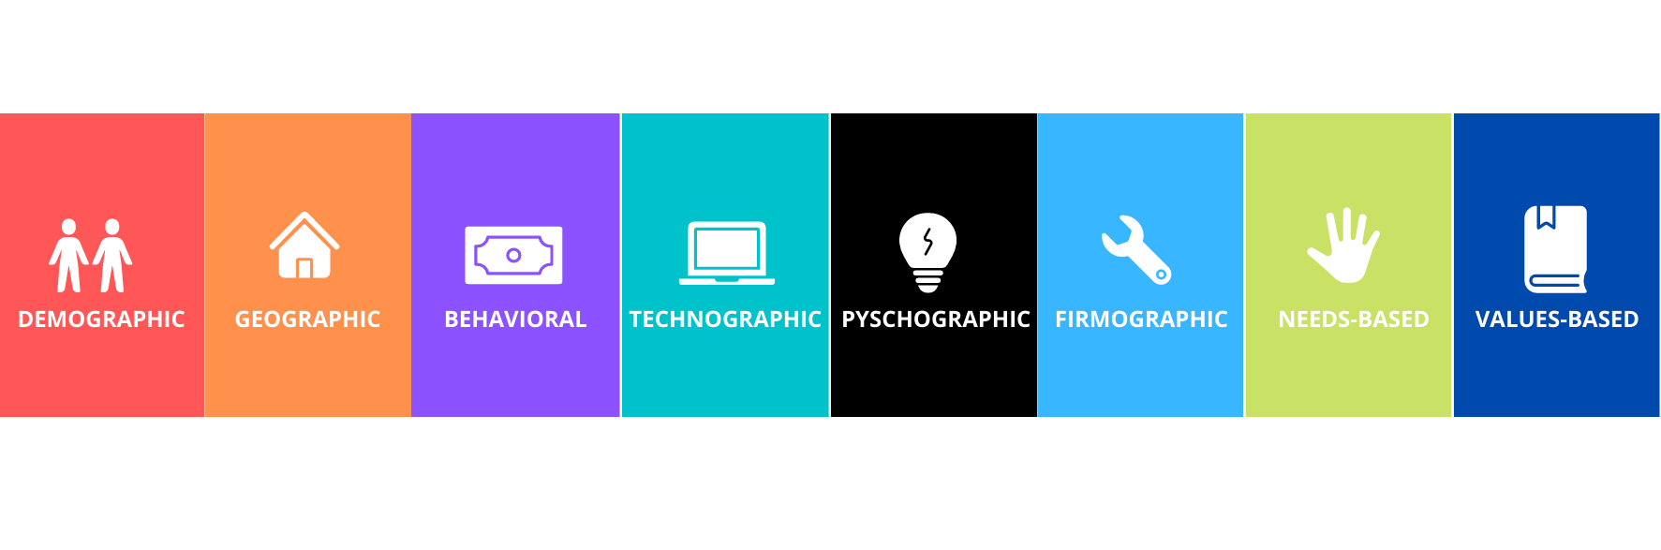
Types of Customer Segmentation Models

Slide 5
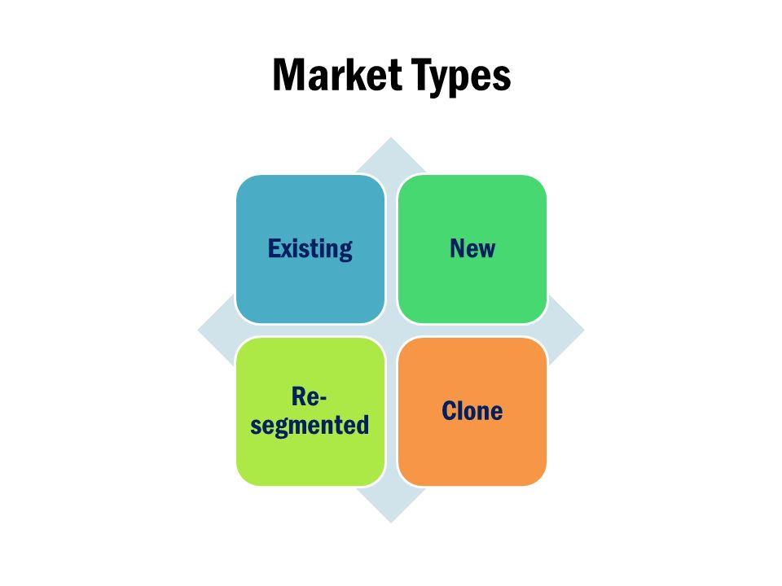
MARKET

Slide 6
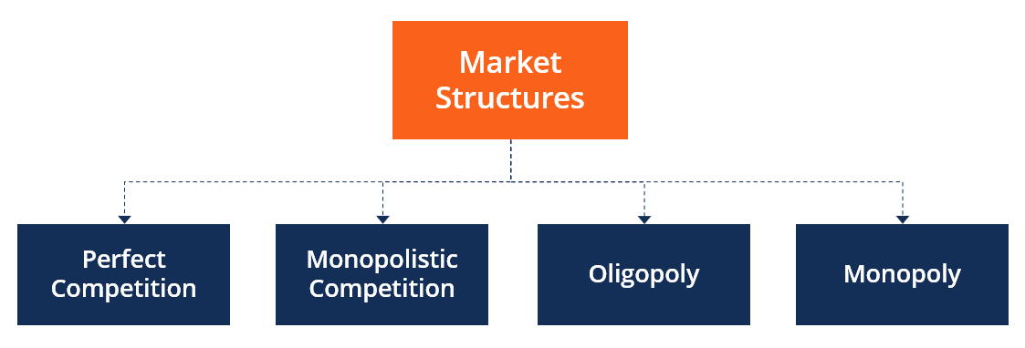

Slide 7
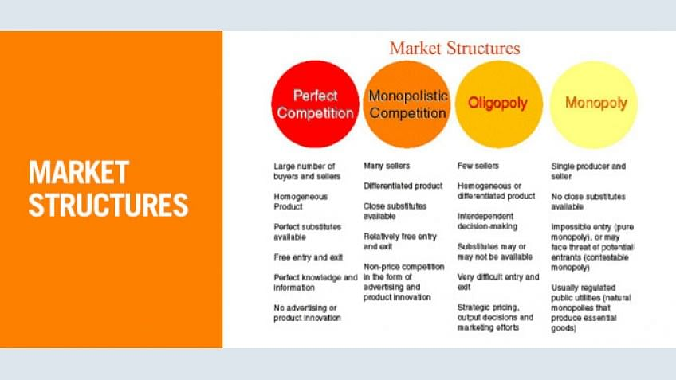
Customer Segmentation Models

Slide 8
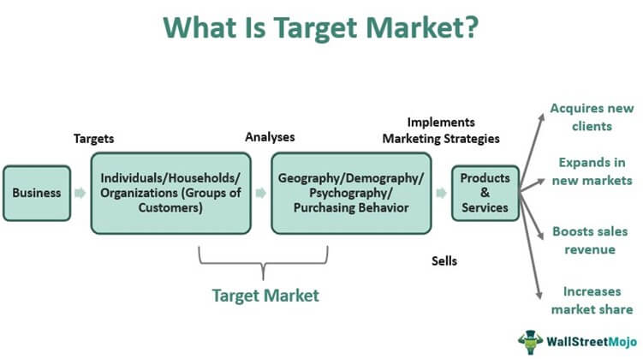

Slide 9
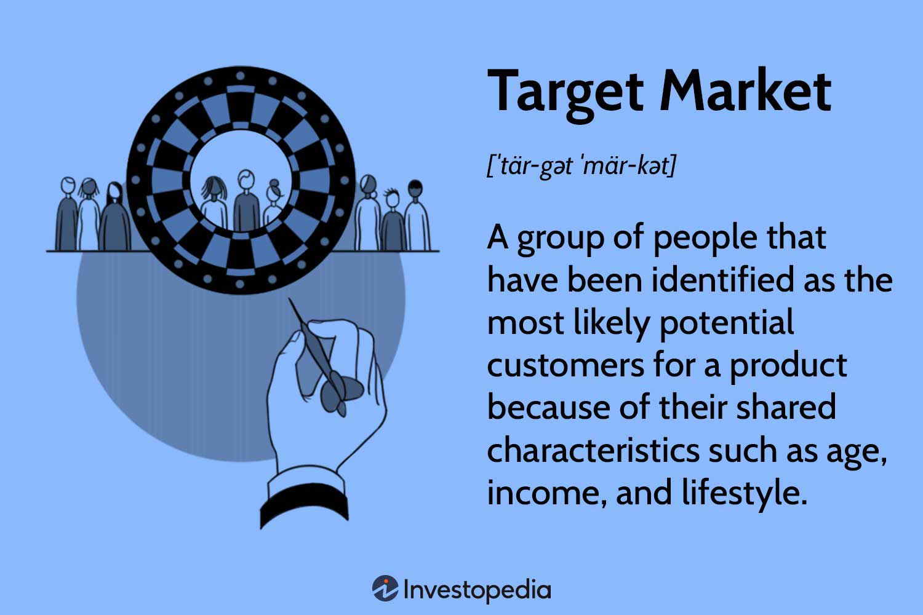

Slide 10
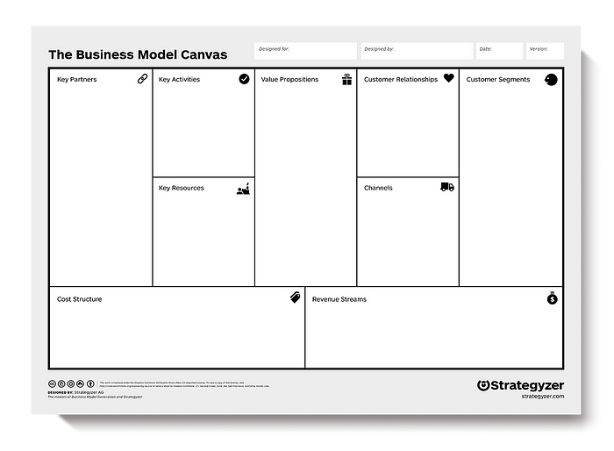

Slide 11
